Slide 1


Renton Fish and Game Club
USPSA
March 202
Match Booklet
Match Director: Eric Beerbaum
Range Master: Marcel Englmaier
Stats: Marcel Englmaier
Round Count: 132

Slide 2
Stage 1 Tropical Trauma Course Designer: Jordan Rogers
Tropical Trauma is a 24 round, 120 point Comstock Long course. There are 11 USPSA targets and 2 steel targets. The best two hits per target will score. Steel must fall to score. The start signal is audible.
The start position is standing with heels touching marks. Handgun unloaded and holstered. PCC unloaded, stock on belt, muzzle pointing down range.
On the audible start signal, engage all targets as visible from within the shooting area. All barrels are soft cover.

Slide 3
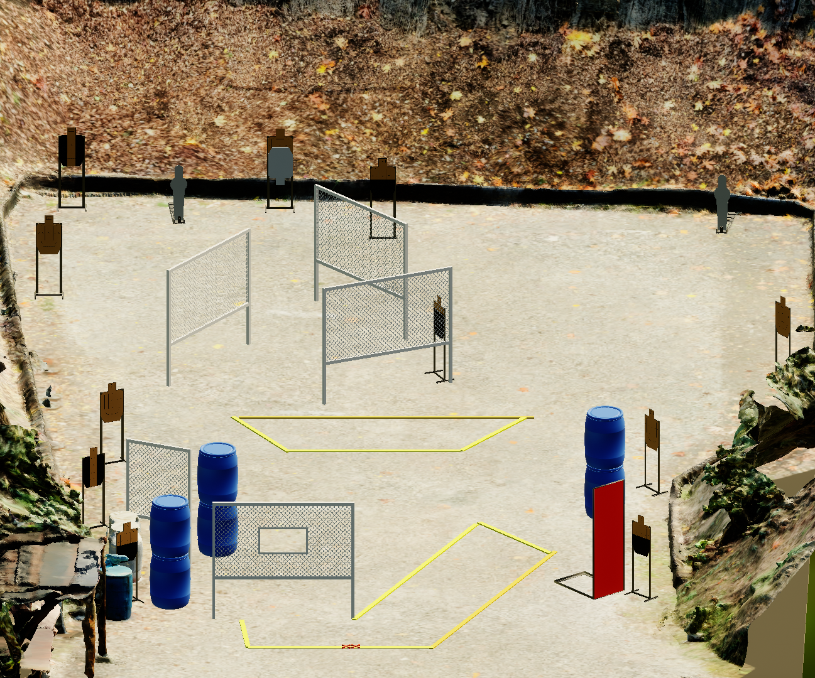
 | Stage 1 Tropical Trauma Course Designer: Jordan Rogers

Slide 4
Stage 2: CM 03-08 Madness

Slide 5
Stage 3
Negative Space
Course Designer: Eric Beerbaum
Negative Space is a 20 round, 100 point Comstock medium course. There are 8 USPSA targets and 4 steel targets. The best two hits per target will score. The start signal is audible
The Handgun start position is inside the shooting area, heels touching Xs, handgun loaded and holstered, wrists below belt.
The PCC start position is inside the shooting area, heels touching Xs, PCC loaded, stock on belt, muzzle generally downrange.
On the audible start signal, engage targets as they become visible.
Notes:
‹#›
‹#›

Slide 6
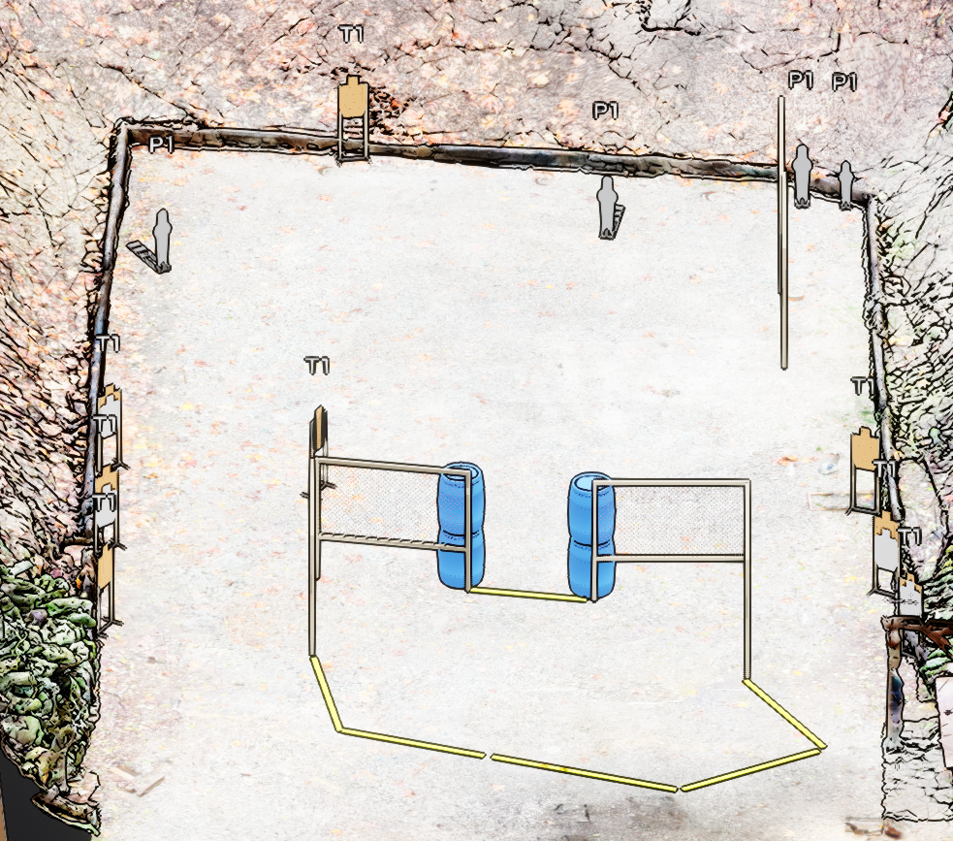
Stage 3
Negative Space
Course Designer: Eric Beerbaum

Slide 7
Stage 4
L-Shaped Ambush
Course Designer: Eric Beerbaum
L-Shaped Ambush is a 22 round, 110 point Comstock medium course. There are 8 USPSA targets, 3 large poppers, and 3 small poppers. The best two hits per target will score. The start signal is audible.
The Handgun start position is handgun loaded and holstered, both hands touching tree A.
The PCC start position is PCC loaded, stock on belt, muzzle touching tree A.
On the audible start signal, engage targets as they become visible.
Notes:
‹#›

Slide 8
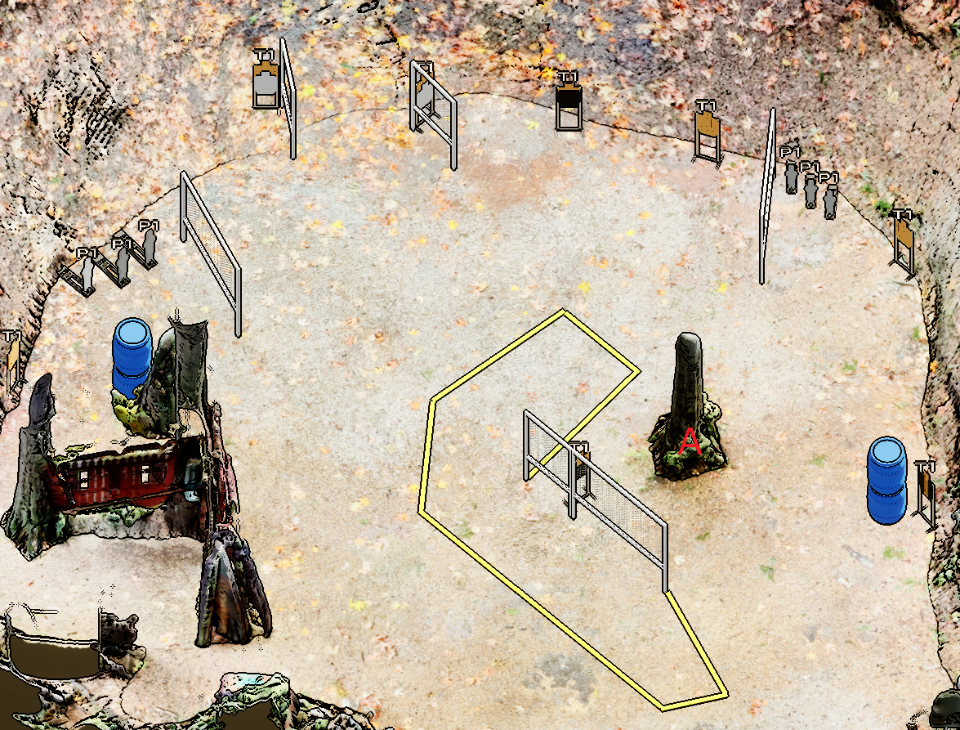
Stage 4
L-Shaped Ambush
Course Designer: Eric Beerbaum

Slide 9
Stage 5 Only You Can Prevent No-Shoots Course Designer: Jordan Rogers
Only You Can Prevent No-Shoots is a 12 round, 60 point Virginia Count short course. There are 12 USPSA targets. The best ONE hit per target will score. The start signal is audible.
The start position is standing completely outside the shooting area. Handgun loaded and holstered, hands touching upper marks on tree-box. PCC loaded with muzzle touching lower mark on tree-box.
On the audible start signal, engage targets as visible from within the shooting area.

Slide 10
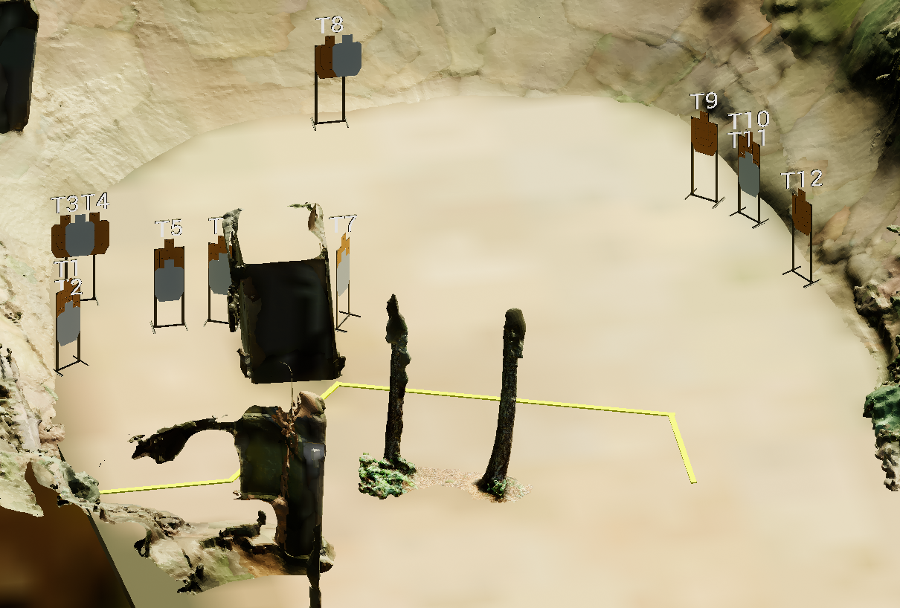
 | Stage 5 Only You Can Prevent No-Shoots Course Designer: Jordan Rogers

Slide 11
Stage 6 Shuffleboard Standards Course Designer: Jordan Rogers
Shuffleboard Standards is a 24 round, 120 point Fixed Time Standards Exercise. There are 8 USPSA targets. The best THREE hits per target will score. The start and stop signal are audible. The time allowed for each string is 5 seconds.
START POSITION String 1: Standing in box A. Handgun loaded and holstered, PCC loaded, stock on belt, muzzle pointing downrange. String 2: Standing in box C. Handgun loaded and holstered. PCC loaded, stock on belt, muzzle pointing downrange.
STAGE PROCEDURE String 1: On the start signal, engage targets T1 & T2 OR T5 & T6 from any box(s) with three rounds each, perform a mandatory reload and engage remaining two targets with three rounds each STRONG HAND ONLY. String 2: On the start signal, engage targets T3 & T4 OR T7 & T8 from any box(s) with three rounds each, perform a mandatory reload and engage remaining two targets with three rounds each WEAK HAND ONLY.

Slide 12
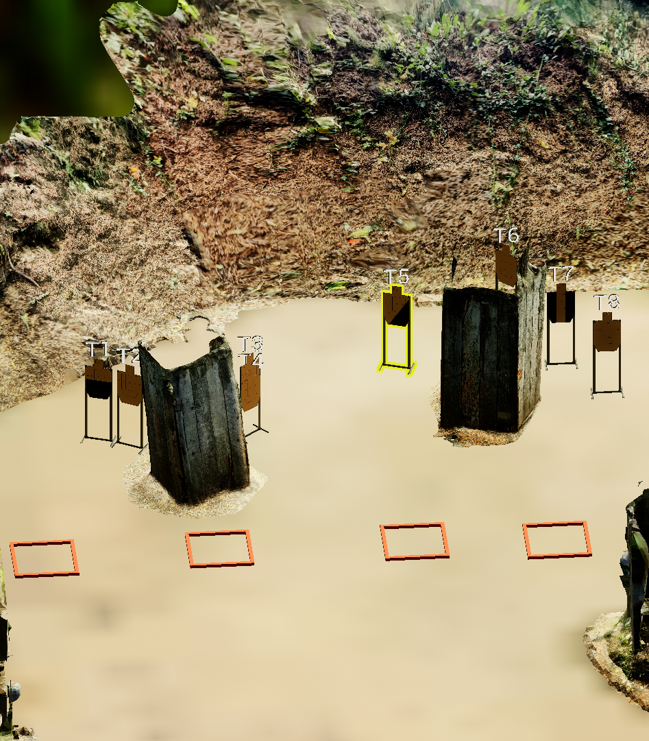
 | Stage 6 Shuffleboard Standards Course Designer: Jordan Rogers
A
B
C
D

Slide 13
Stage 7 Devil’s Delights Course Designer: Jordan Rogers
Devil’s Delights is a 16 round, 80 point Comstock medium course. There are 6 USPSA targets and 4 steel targets. The best two hits per target will score. Steel must fall to score. The start signal is audible.
The handgun start position is standing outside the shooting area, feet straddling start stick, facing UPRANGE, wrist above shoulders. Handgun is loaded and holstered. The PCC start position is standing outside the shooting area, feet straddling start stick. PCC loaded with stock on belt, muzzle pointing down range.
On the audible start signal, engage targets as visible from with the shooting area. White paper targets are scoring targets, brown targets are no-shoots.

Slide 14
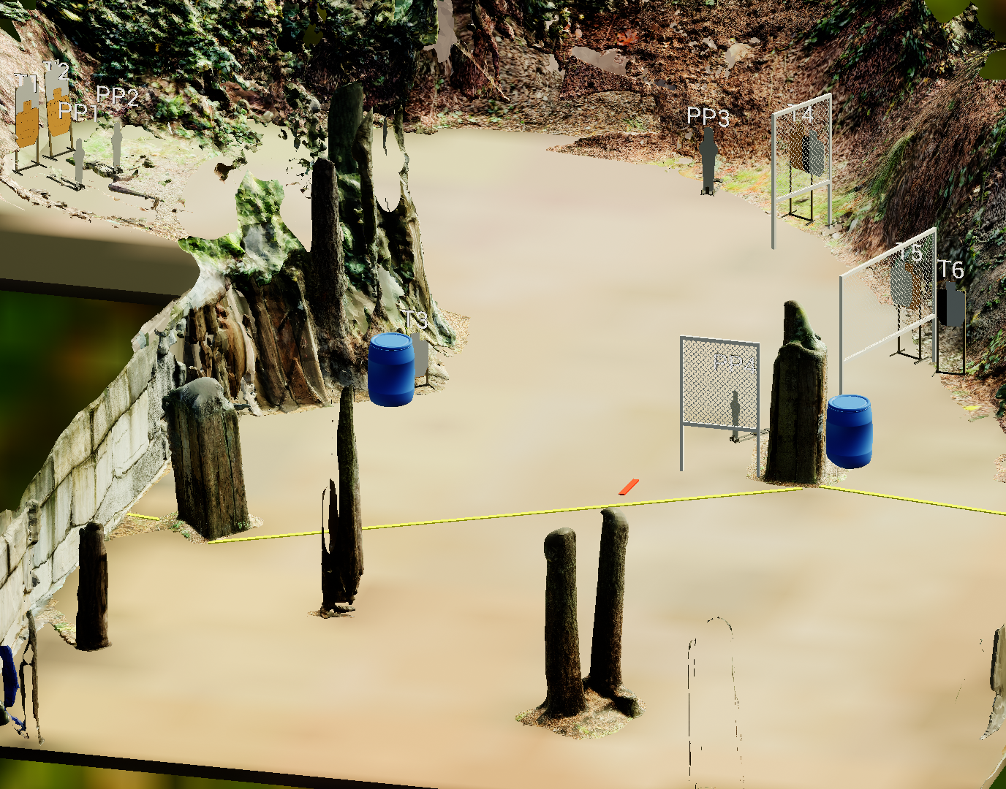
 | Stage 7 Devil’s Delights Course Designer: Jordan Rogers

